Slide 1


Over 3 Decades
of Excellence in Refrigeration

Slide 2





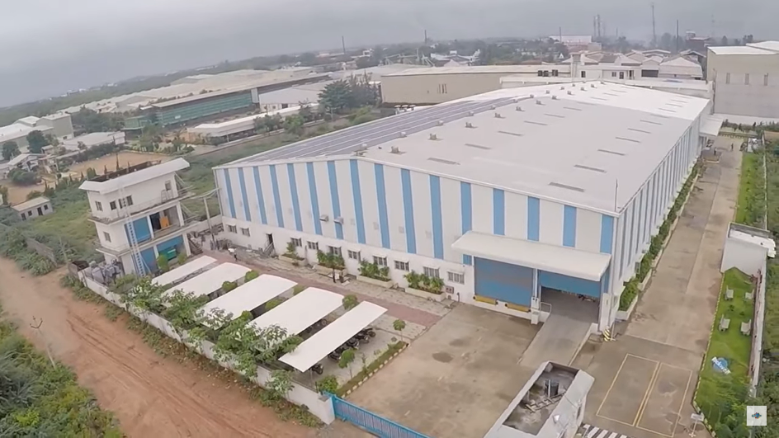


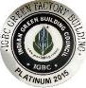



COMPANY PROFILE
ST
To introduce
GREEN FREEZERS consuming 53% lesser energy
To introduce
Solar Refrigeration Freezer in INDIA
To introduce CFC Free
To introduce EUTECTIC FREEZERS RUNNING 24hrs without Power
ROCKWELL has one
of the Largest NABL certified Testing LAB
Established in 1986, Rockwell Industries Limited has led the way in India’s commercial refrigeration industry. Over the years, we have become a trusted leader, consistently innovating to meet the unique and evolving needs of businesses across the country. As an ISO 9001:2015 certified company, we are committed to excellence, offering a comprehensive range of high-performance, energy-efficient refrigeration solutions that prioritize quality, reliability, and environmental responsibility.
Our state-of-the-art manufacturing facilities in Hyderabad & Lucknow - India, span over 200,000 square feet, with an annual production capacity exceeding 400,000 units. At Rockwell, we take pride in our robust R&D capabilities, including a precision-controlled temperature and humidity test lab, allowing us to design and deliver bespoke refrigeration solutions that enhance efficiency, freshness, and profitability for our clients.
Guided by our core values—Trust, Innovation, and Sustainability—we are dedicated to on-time delivery, responsive customer service, and developing environmentally-friendly products that respect the planet. Our passionate team works to make Rockwell a great place to work, fostering a culture of employee excellence and commitment to customer satisfaction. Looking ahead, we remain focused on advancing refrigeration technology, helping businesses flourish with solutions that are as reliable as they are forward-thinking.
Quality testing lab
Continuous performance testing lab
National Accreditation Board of Testing and Calibration Laboratories (NABL)
2

Slide 3
10
Branches
Across India
The World
Within Our Reach
45+
Exclusive
Brand Store
3100+
Trade
Partners
500+
Service Centres
NORTH AMERICA
America
Tuscon
Panama
EUROPE
Netherlands
Germany
ASIA
Turkey
Lebanon
Jordan
Saudi Arabia
Afghanistan
Nepal
Bangladesh
Sri Lanka
Cambodia
Vietnam
Philippines
Japan
100+
Corporate
Clients
SOUTH AMERICA
Bolivia
Paraguay
Uruguay
AFRICA
Morocco
Mauritania
Nigeria
Uganda
Kenya
Tanzania
Mauritius
140+
Products
27
Countries
Reached & Growing…

Slide 4

OUR JOURNEY OF INFINITE POSSIBILITIES
A Vision that’s driven with passion, knowledge and commitment.
1986
1990
1994
1995
1999
2000
2005
Rockwell Incorporation
Manufacturing capacity of 500+ units a year
Commence operations at UNIT 1
Production
capacity of 9000+ units a year
1st big deal.
Shook hands with
Coca Cola.
Achieved Top
Supplier for Coke
in the country
1st order from UNICEF for Vaccine Storage Coolers
U-1 Expansion
Scaled up manufacturing capacity to
36,000+ per year
Freezer Range Introduced
Introduced 1st
in Country EUTECTIC COOLER
2017
2016
2015
2013
2008
2007
Commenced expansion of Distribution Network
pan India
Introduced India’s First Solar Freezer
Commenced Exports
Awarded India’s First IGBC Platinum Rating in the Industry
Commenced operations at Unit 2 Production capacity of 4,00,000 units a year
Adopted Kaizen + methodology that resulted in enhanced production to 1,05,000+ per year
A host of National Ice-cream brands added to our client portfolio
2019
2020
2021
2023
2025
Inauguration of 12 Branch Offices
A 1st in country path defining Converti Green Freezer
Introduced COVID -19 Vaccine Cooler/Freezer to enable administration of vaccines in India
and abroad
Full Range of HORECA refrigeration launched Opened 1st Experience Center in the country in refrigeration domain
New Factory at Lucknow A state-of-the-art facility for VISI COOLER production
Copyrights © 2025 | Rockwell Industries Limited | India | All Rights Reserved.
4

Slide 5
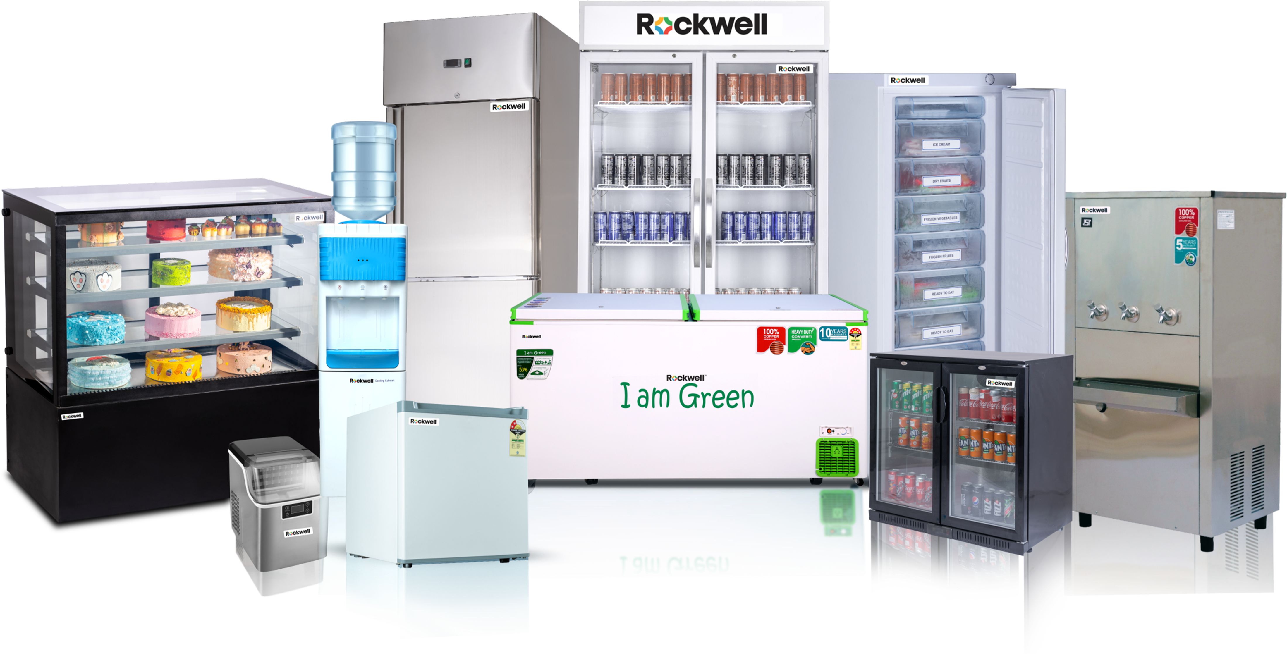

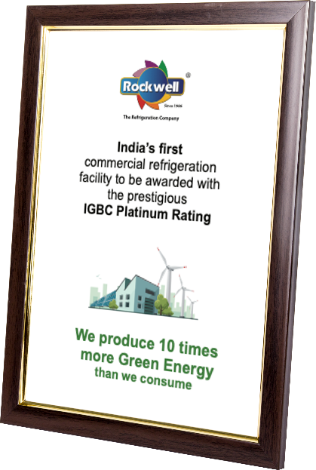





ROCKWELL’S PROMISE OF SUSTAINABILITY
VISION
MISSION
To build a global brand by providing technologically advanced, environmentally sustainable and economical refrigeration solutions
To strive for growth of all stakeholders by delivering customer delight while upholding integrity and
ethics in all our actions
Culture
Rockwell, dwells on a culture that has evolved
over three decades anchored with discipline, integrity & values as the foundation. We adopt ethical practices in delivering high quality, high reliability eco-friendly refrigeration solutions. Holding this as our premise we aim to grow into a global enterprise
Rockwell Green Pledge
To reform, recreate and re-engineer a culture
of change in the manufacturing
of refrigeration products. Our aim
is to educate, and empower
the end user with the power of choice
Copyrights © 2025 | Rockwell Industries Limited | India | All Rights Reserved.
5

Slide 6
Rockwell
Manufacturing
Facilities

Slide 7
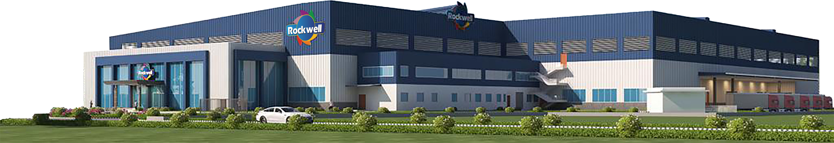
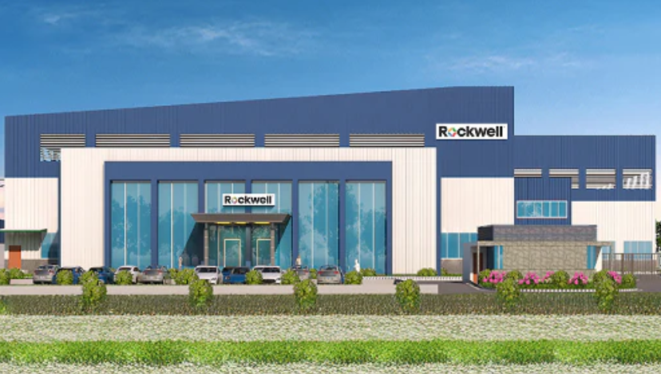
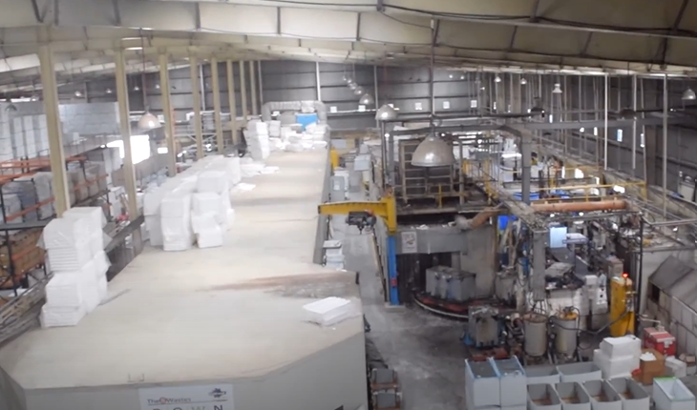
1 FACTORY AT
LUCKNOW : 2.5L Units
2 FACTORIES AT HYDERABAD : 2.5L Units
7

Slide 8





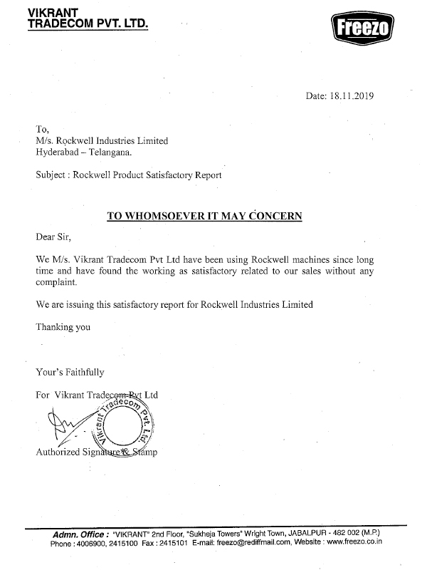
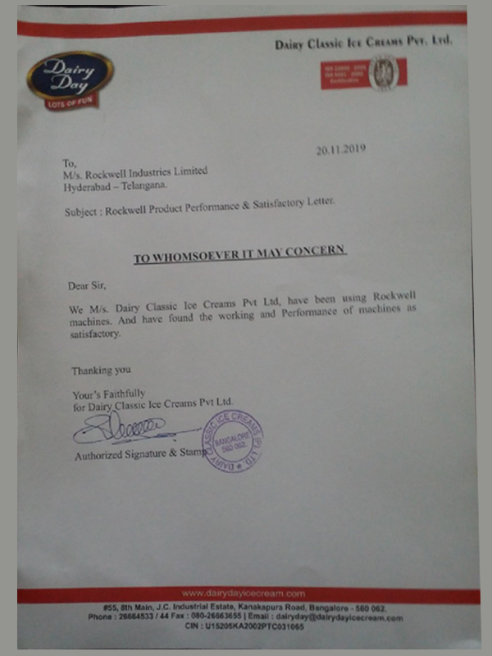
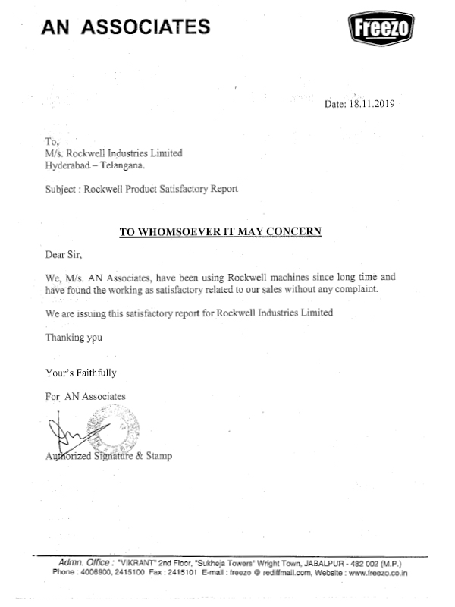
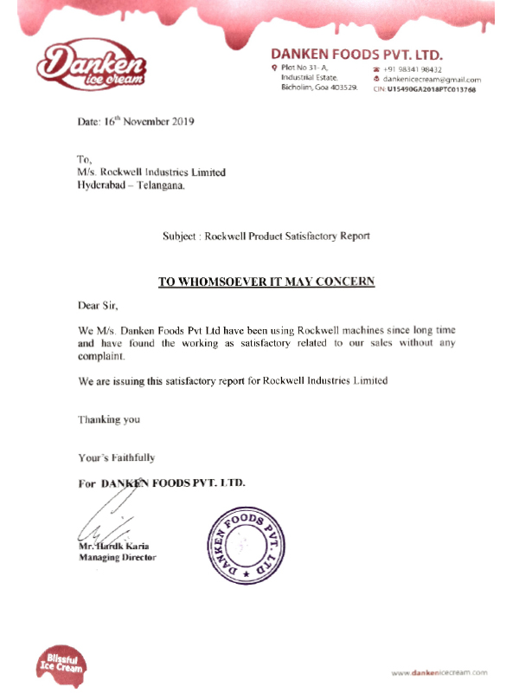
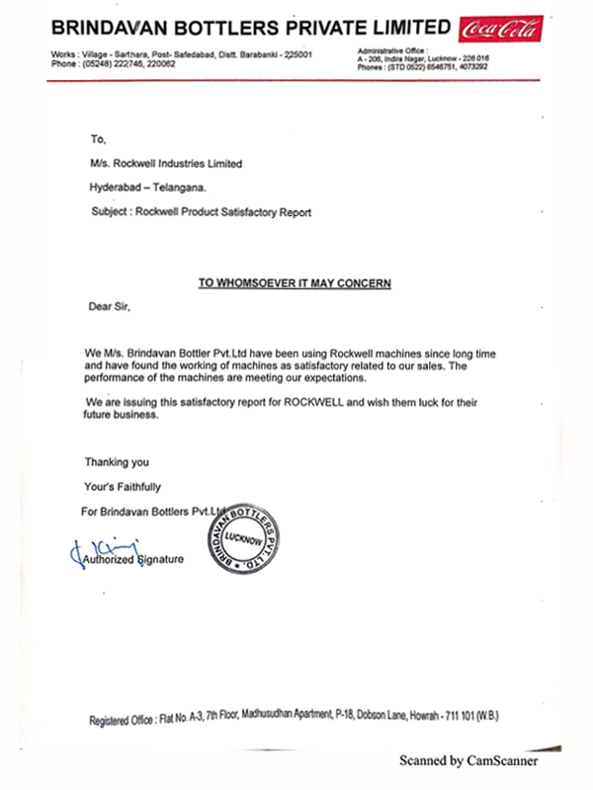
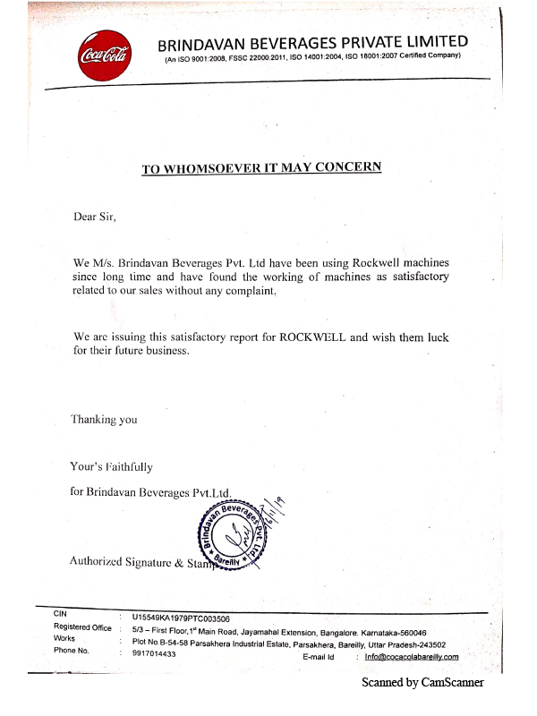
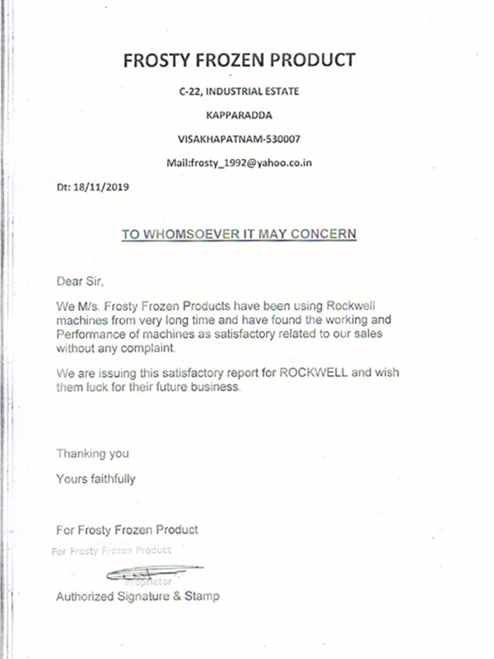
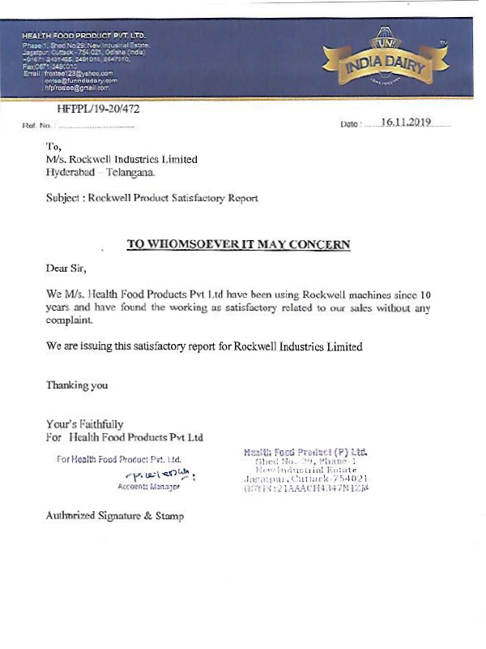
100% ELECTRICITY CONSUMED BY
ROCKWELL COMES FROM RENEWABLE SOURCES
Future is in the AIR
“Just to give an example: a kg of R404 injects into the atmosphere the equivalent of about 4000 kg of CO2, the same amount that a small car would consume to travel the earth’s circumference!”
Copyrights © 2025 | Rockwell Industries Limited | India | All Rights Reserved.

Slide 9









INDUSTRY OUTLOOK
Commercial Refrigeration Market Size India:
8000 Cr.
Industry Growing
by app 21% CAGR
Expected to grow at
25% and reach a size
of 10,000 Cr by 2028
India freezer market size
–> 13Lac units
KEY
FOCUS
AREAS
Advanced automation
Scalable
refrigeration solutions
Investment
in R&D
Continuous improvement initiatives
Commitment to innovation
Copyrights © 2025 | Rockwell Industries Limited | India | All Rights Reserved.
9

Slide 10


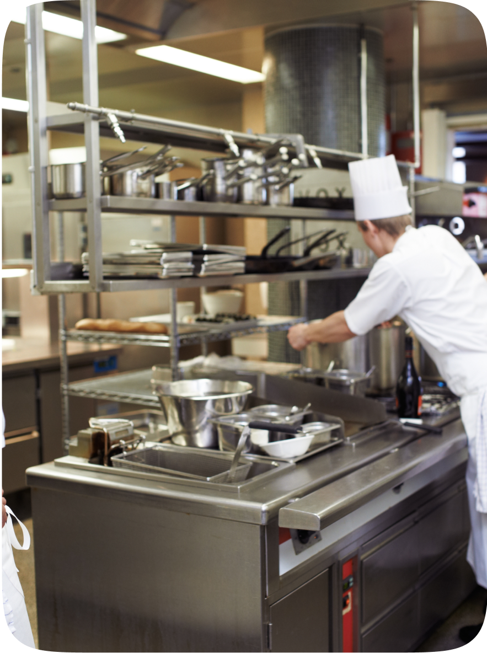



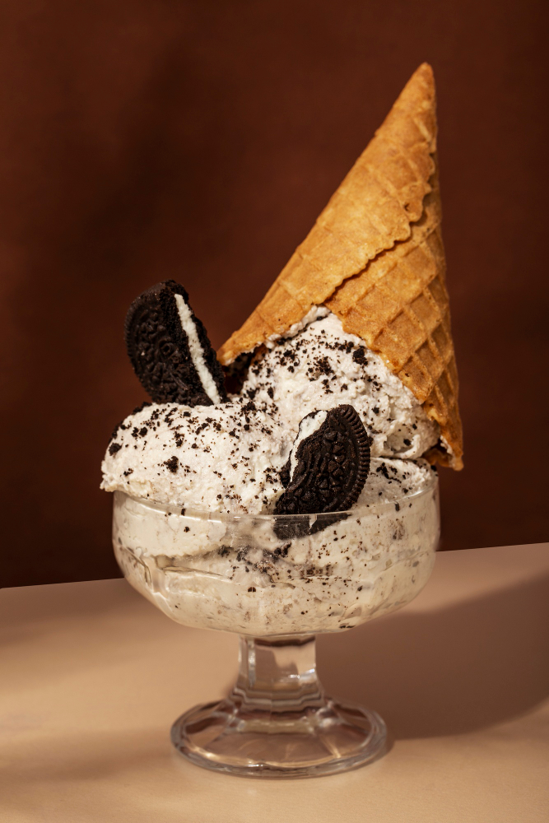
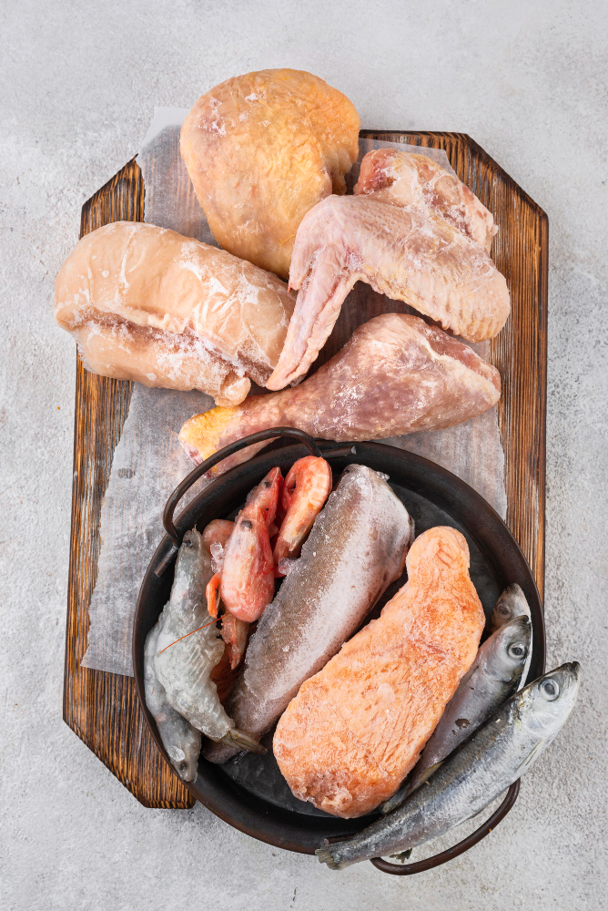




Market
Segments
Dairy
Beverage
Hospitality
Frozen Food
Super-Market
Beer/Wine
Ice-Cream
Frozen Meal/
Sea-Food
Bakery/
Confectionary
Medical/Research
Off-Grid
Floriculture and Food Security Goals.

Slide 11
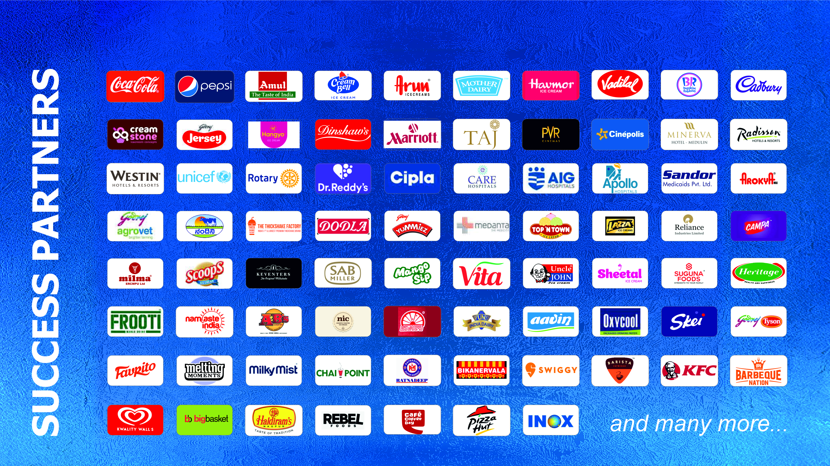

Slide 12
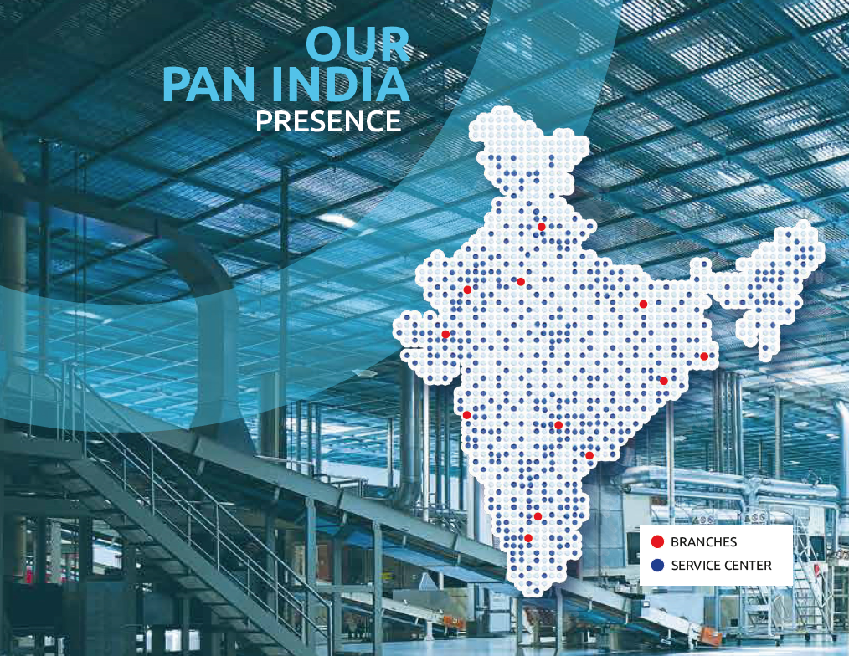
500+ Service Centres
Notes:
16

Slide 13
Rockwell
Product Portfolio

Slide 14
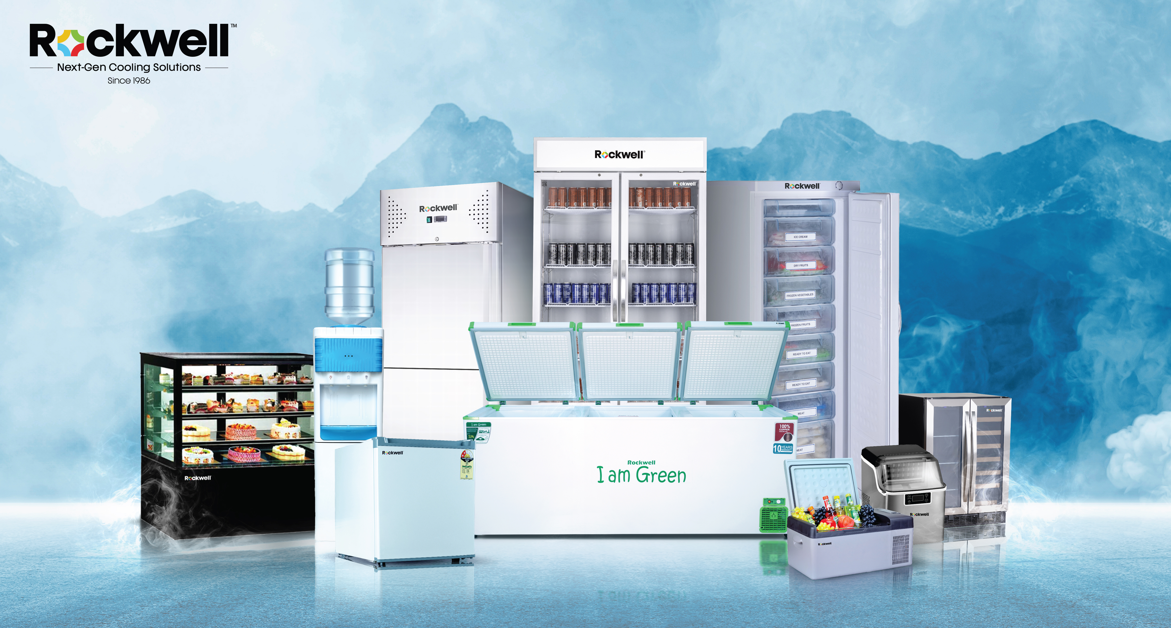

Professional
Kitchen Refrigeration

Slide 15
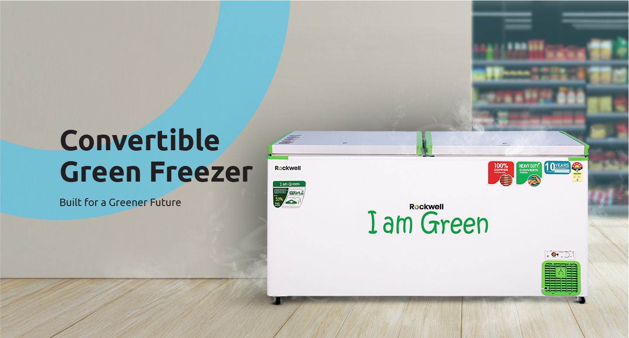
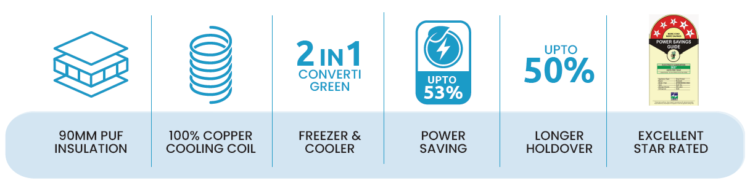
AVAILABLE CAPACITY
200L to 500L
Notes:
1

Slide 16

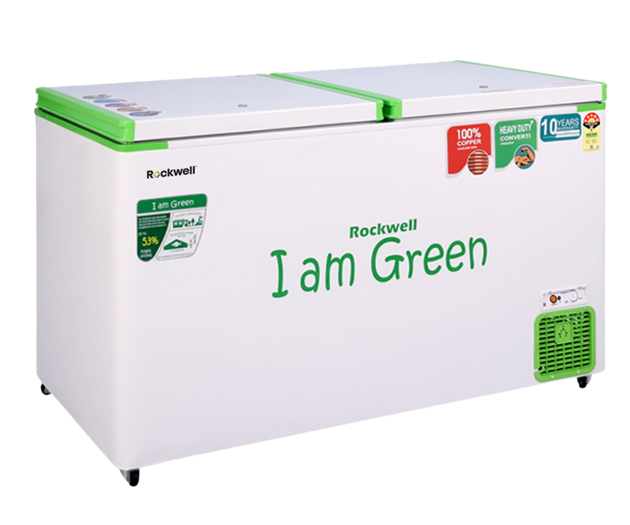
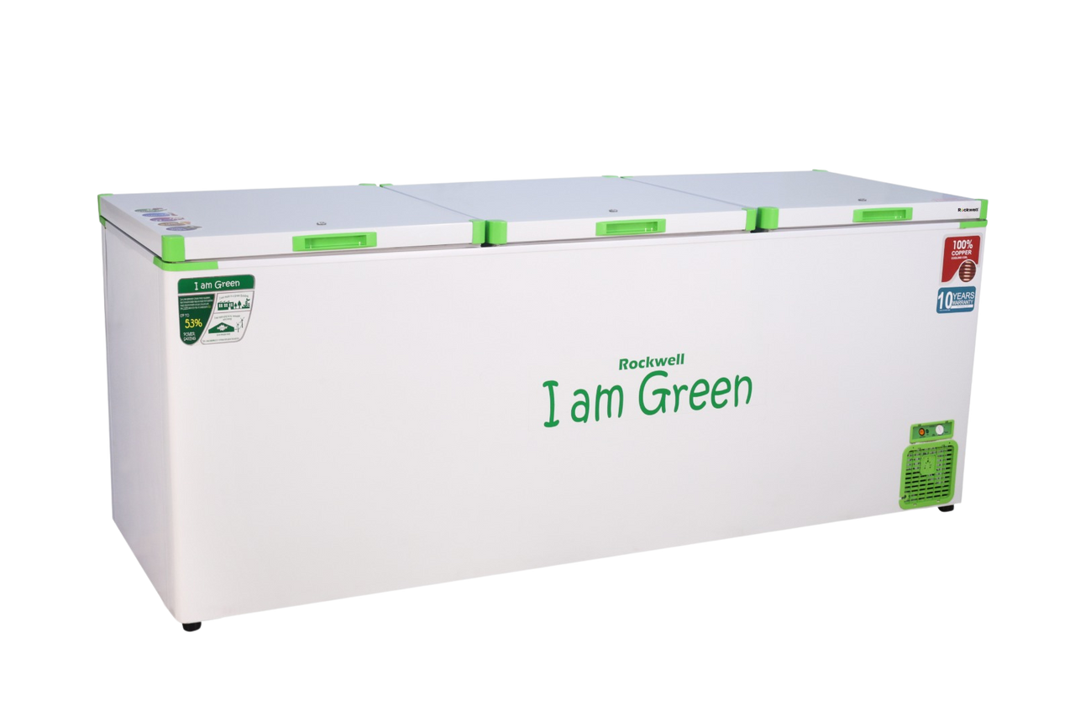
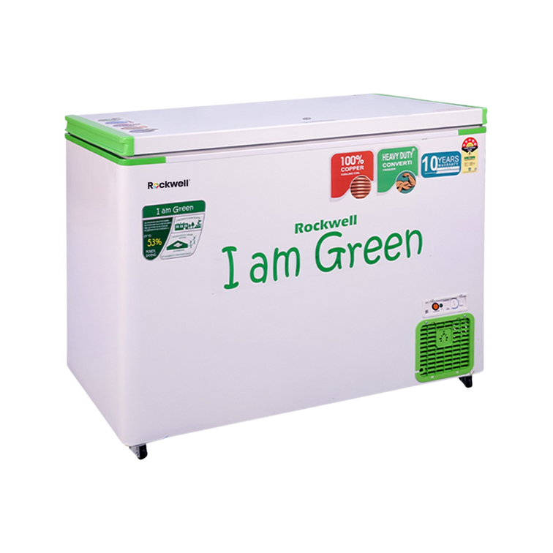
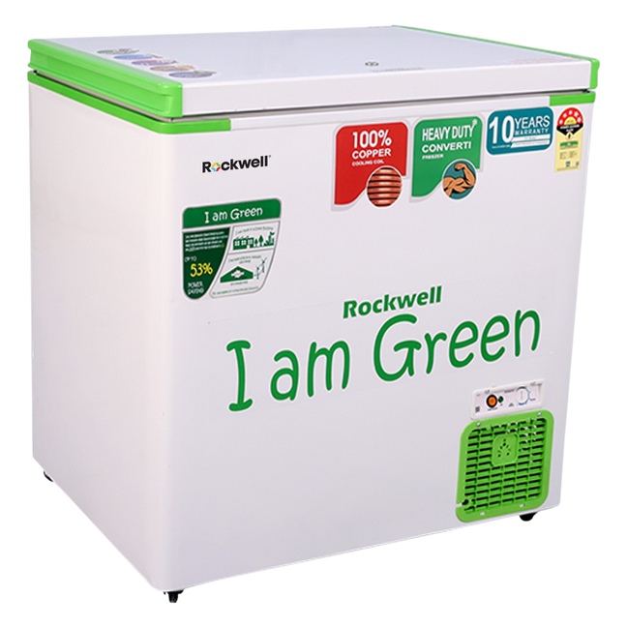
Opening the
Door to a
Green
Greener
FREEZER
Future
Notes:
12

Slide 17
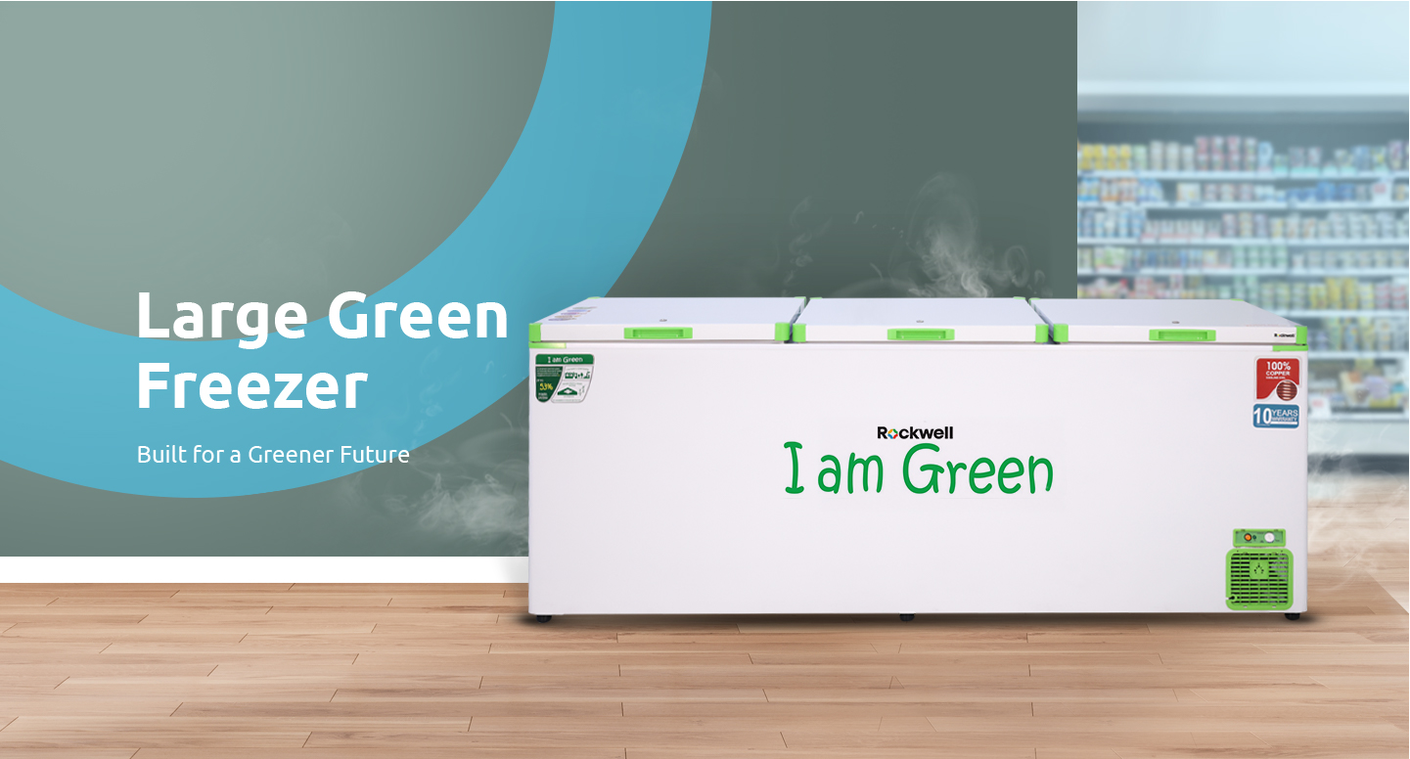
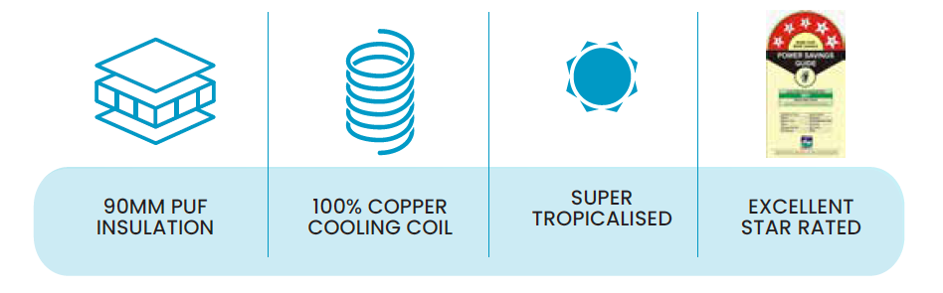
AVAILABLE CAPACITY
900L to 1800L

Slide 18
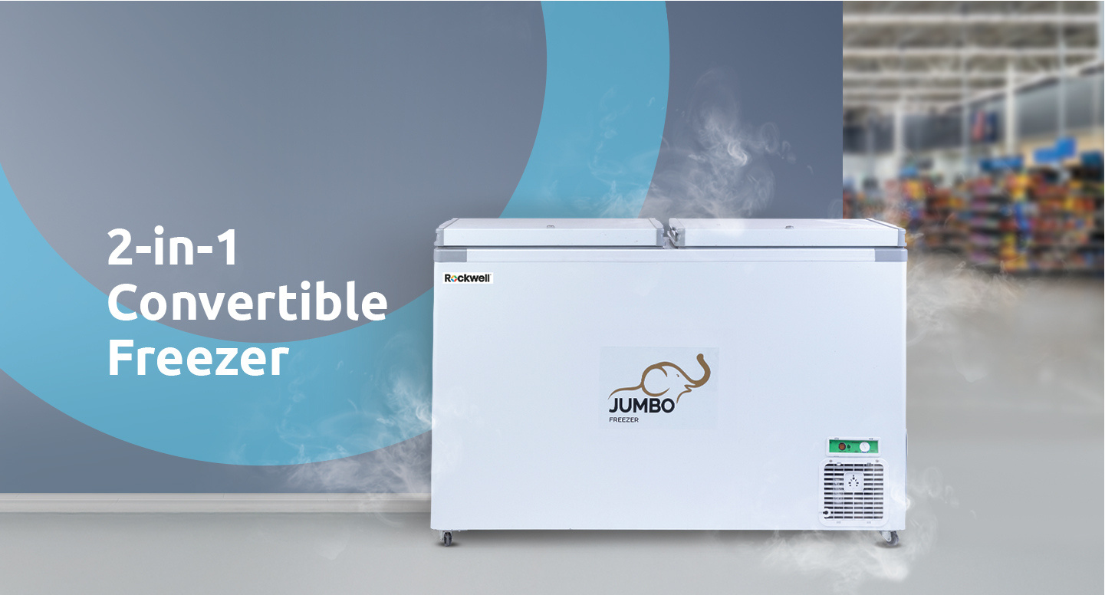
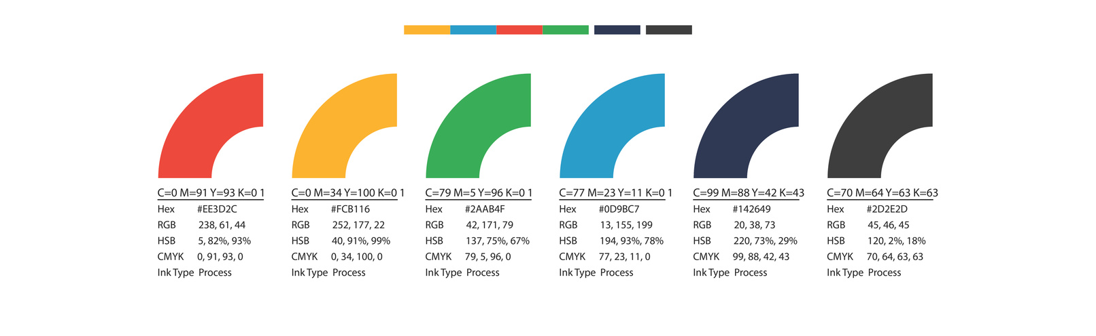


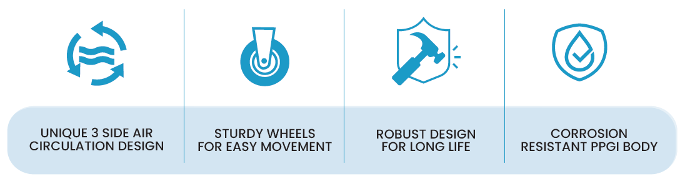
AVAILABLE CAPACITY
70L to 700L
Notes:
1

Slide 19
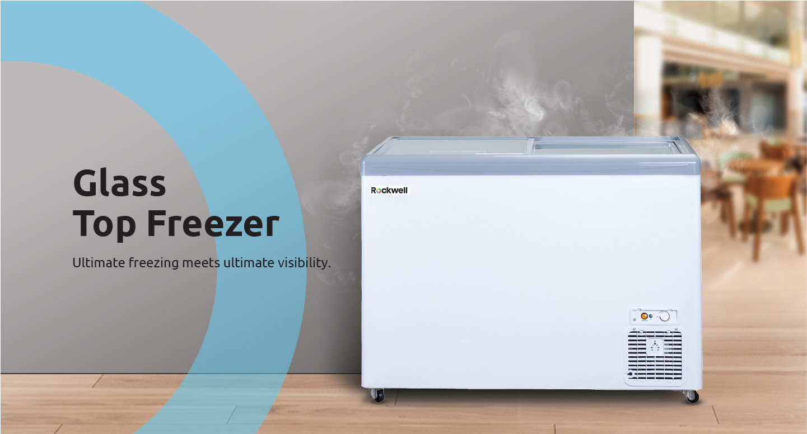

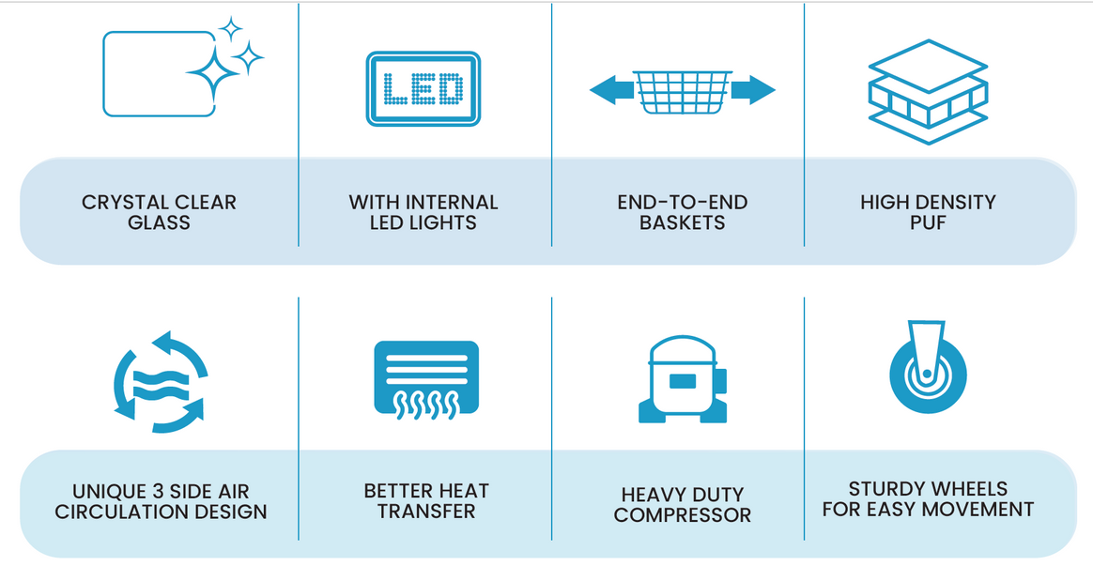

AVAILABLE CAPACITY
200L to 500L
Optional
Notes:
1

Slide 20
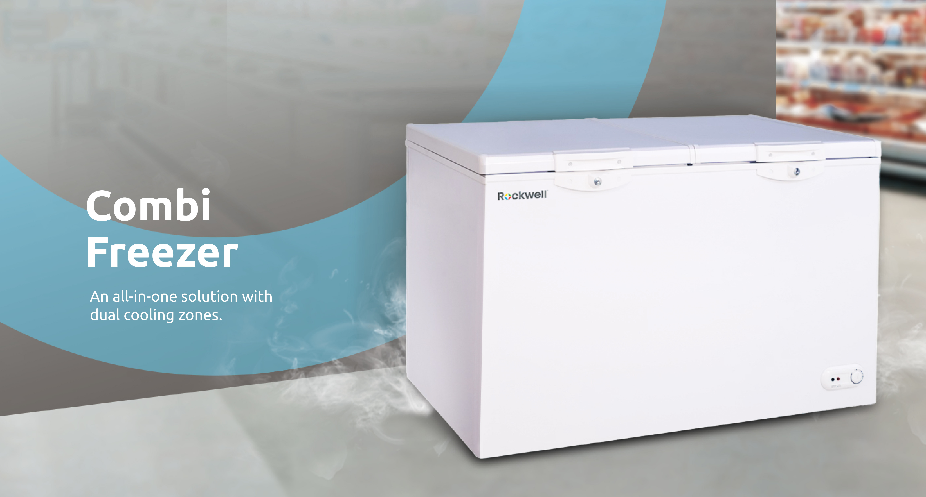
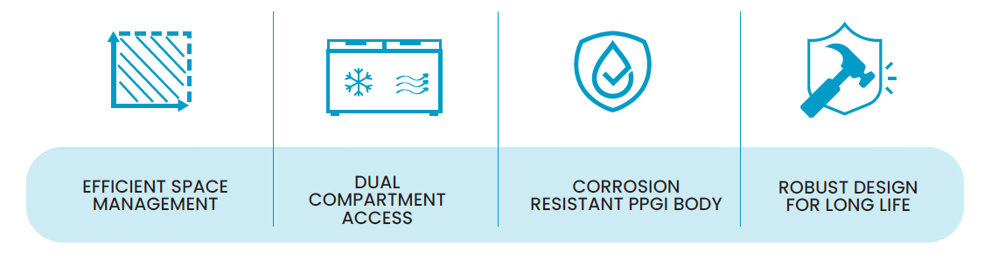
AVAILABLE CAPACITY
250L to 400L
Notes:
1

Slide 21
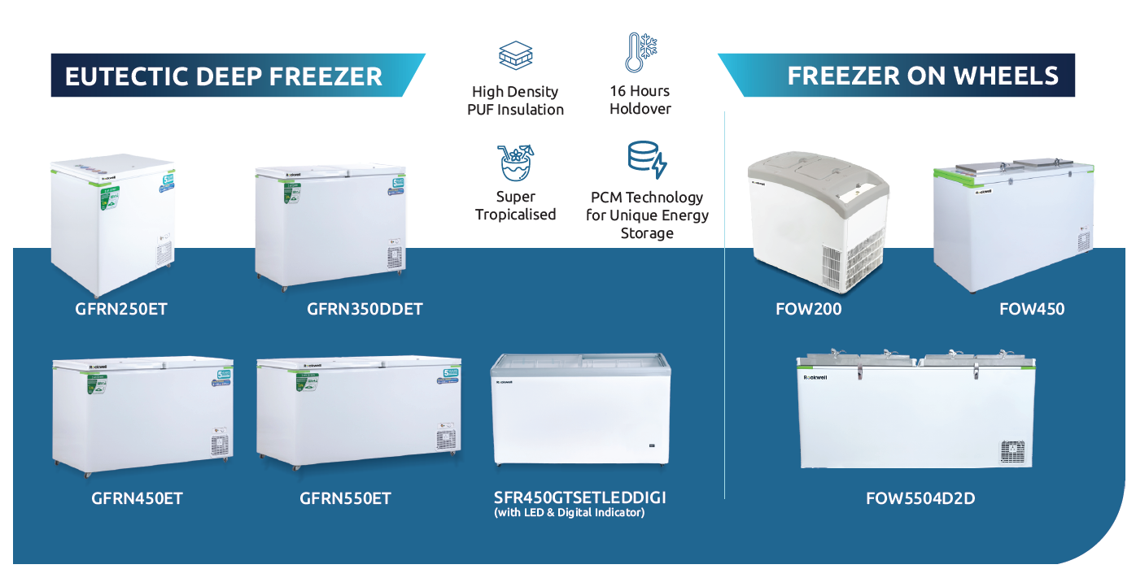
Notes:
1

Slide 22

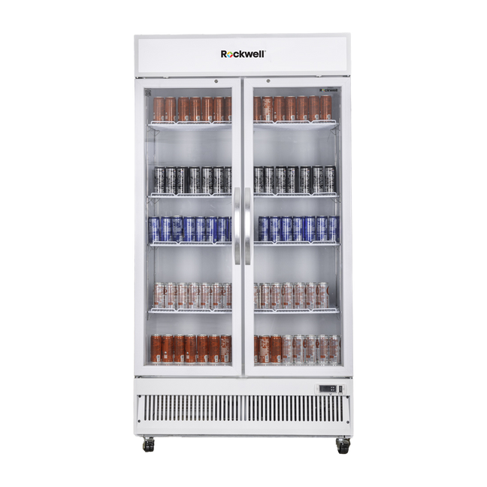
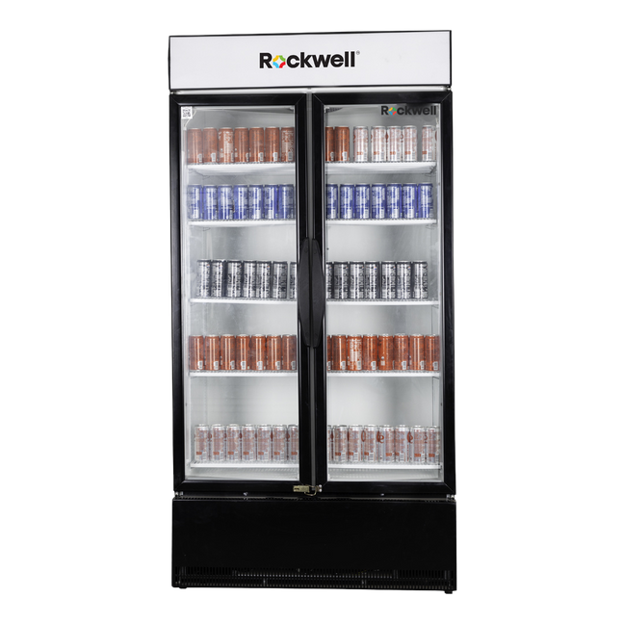
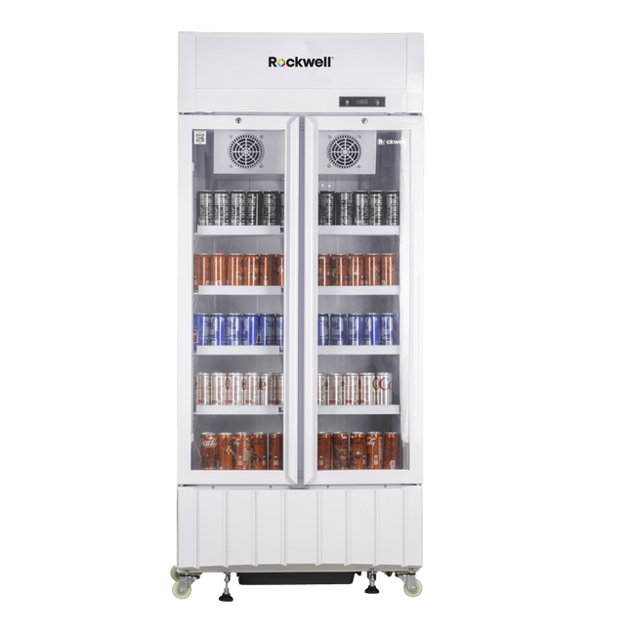
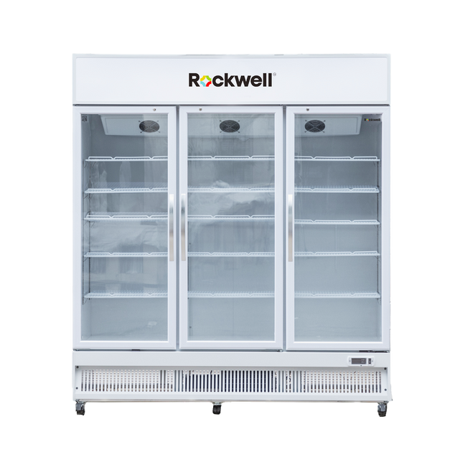
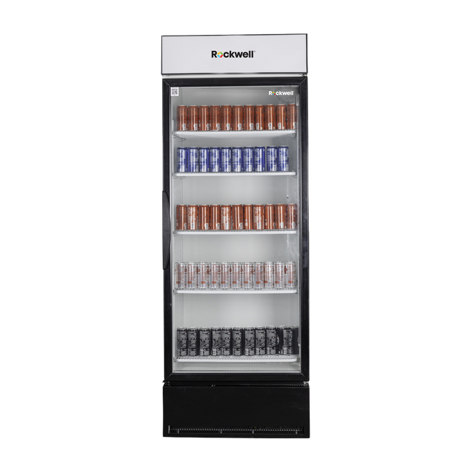
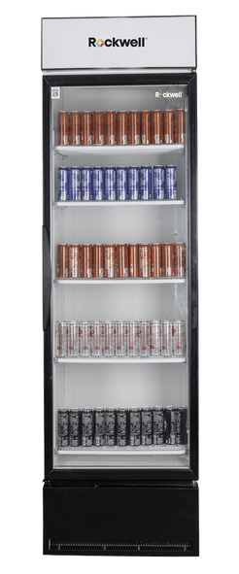

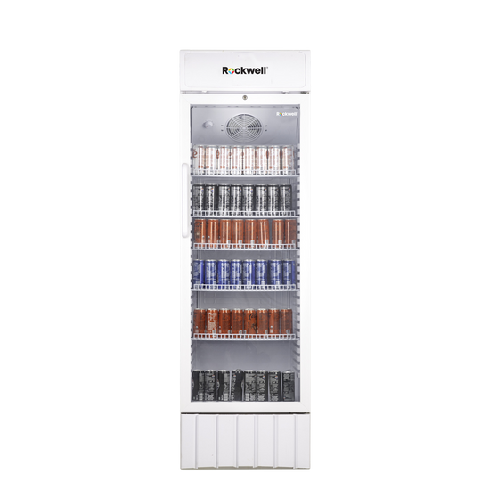
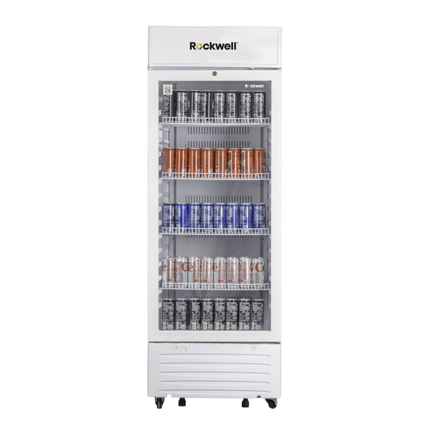
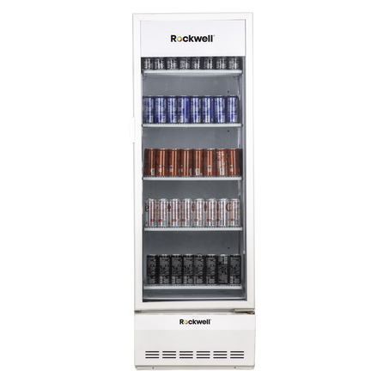
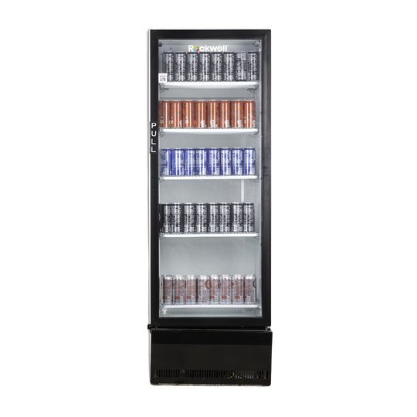
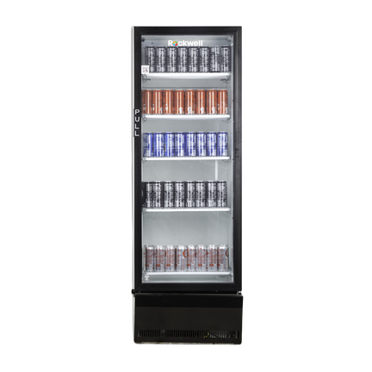
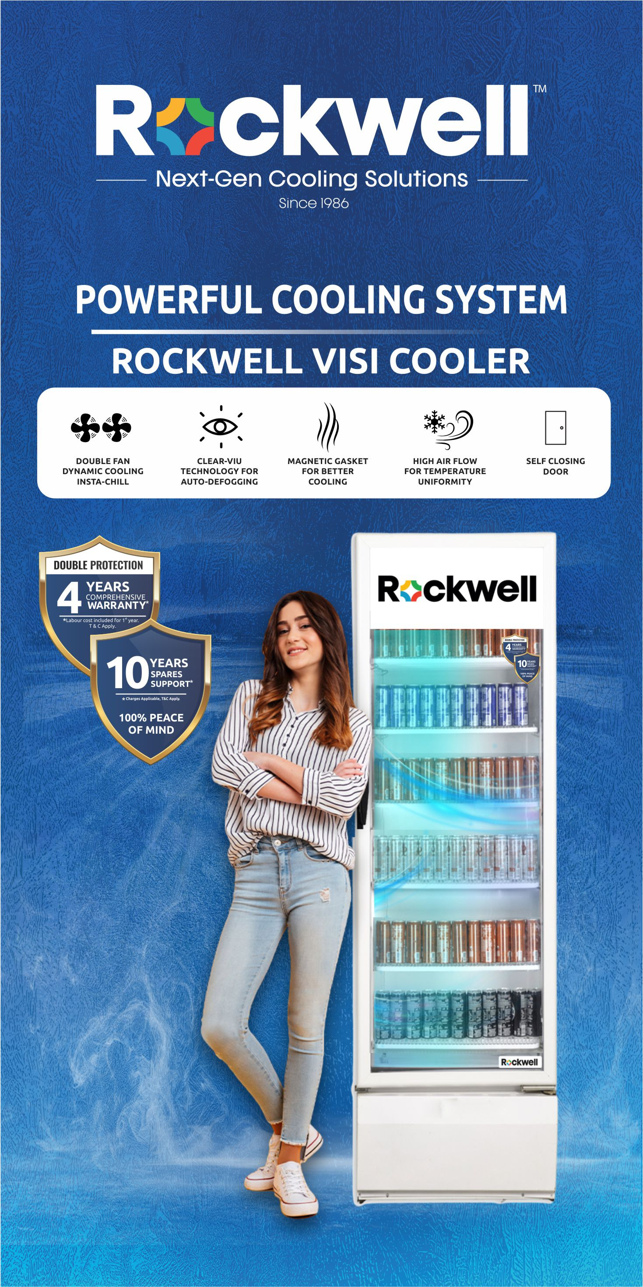
Visi Cooler
AVAILABLE CAPACITY
200L to 1000L
Notes:
1

Slide 23
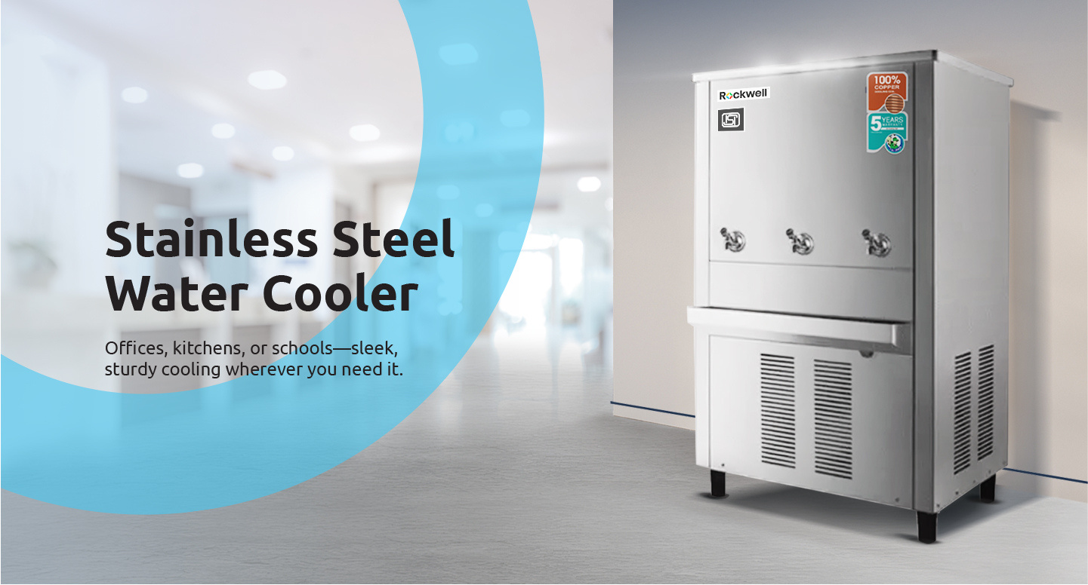

AVAILABLE CAPACITY
40L to 400L
Notes:
1

Slide 24


Notes:
1

Slide 25


Chosen by the
World’s Best.

Slide 26

Notes:
1

Slide 27


Slide 28


AVAILABLE MODELS
3 Ft. | 4 Ft. | 5 Ft.
Notes:
1

Slide 29

Medical Refrigeration Solutions
Medical Freezers
Laboratory Freezers
Laboratory Refrigerators
Ultra Low Temp. Freezers
Sub-Zero Vaccine Refrigerator
Mother’s Milk Bank
Ice-lined Refrigerators
Notes:
1

Slide 30






AWARDS & RECOGNITIONS
AXIS Bank & Dun & Bradstreet Business Excellence Award
Indian Economy & Market
IEM Young Achievers Award 2022
Times
Business Award 2021
IGBC Platinum Rating
India SME Awards 2023
Top 100 Enterprise of India
Copyrights © 2025 | Rockwell Industries Limited | India | All Rights Reserved.
30

Slide 31













OUR COMMITMENT TO CSR
About Ekal
India | Nepal
Ekal Vidyalaya is a Movement involved in integrated & holistic development of rural & tribal India & Nepal. The main activity undertaken in this movement is to run one-teacher school (known as Ekal Vidyalayas) all over India, in the remotest rural & tribal village to take the education to every child.
1,02,552
Schools
26,32,065
Students
13,16,106
Boys
13,15,959
Girls
Copyrights © 2025 | Rockwell Industries Limited | India | All Rights Reserved.

Slide 32









BRINGING EDUCATION AND EMPOWERMENT
TO REMOTE RURAL INDIA
ROCKWELL HAS ADOPTED MORE THAN
EMPOWERING THE UNDERPRIVILEGED
150+
30,000+
Schools with
Students
Rockwell Supports
Blind School for Kids
by providing
good Infrastructure
Supporting 3 Underprivileged
Star Kids for Table Tennis
Copyrights © 2023 | Rockwell Industries Limited | India | All Rights Reserved.
32
Copyrights © 2025 | Rockwell Industries Limited | India | All Rights Reserved.

Slide 33









ROCKWELL EMPOWERING DIFFERENTLY ABLED PEOPLE
Mr. Yadagiri
Production Department
Ms. Anitha
Sales Department
Ms. Punyavathi
Production Department
Ms. Heera
Sales Department
Mr. Anjaneyulu
Production Department
Started : 05.10.2019
5.67+ Lakhs
Meals served till date
Lunch Program
Copyrights © 2025 | Rockwell Industries Limited | India | All Rights Reserved.
33

Slide 34

















ENGAGEMENT ACTIVITIES
Training
Moments that matter
Team Outings
Special Events
Home Connect
Copyrights © 2025 | Rockwell Industries Limited | India | All Rights Reserved.

Slide 35





WE ARE IN MEDIA
Copyrights © 2025 | Rockwell Industries Limited | India | All Rights Reserved.
35

Slide 36
Thank You

